Slide 1
Topic: Scale Drawings
EQ: How to produce scale drawings to build and decorate?

Slide 2
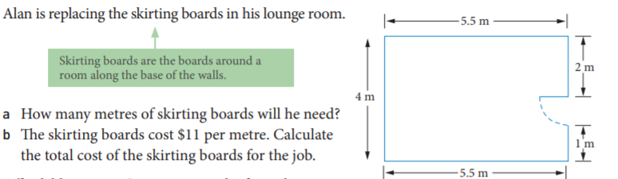
24
7
30
Scale Drawings
Date
EQ: How to produce scale drawings to use to build and decorate?
Example:

Slide 3
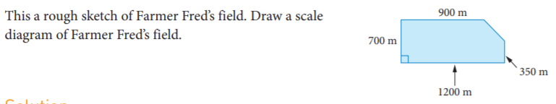
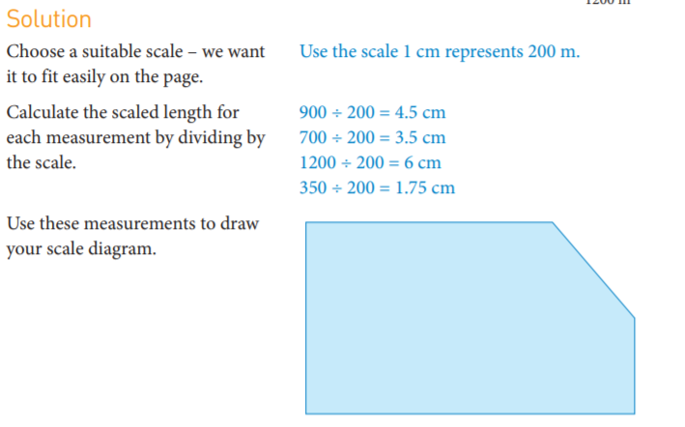
24
7
30
Scale Drawings
Date
EQ: How to produce scale drawings to use to build and decorate?
Example:

Slide 4
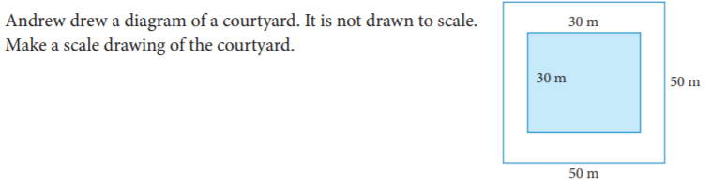
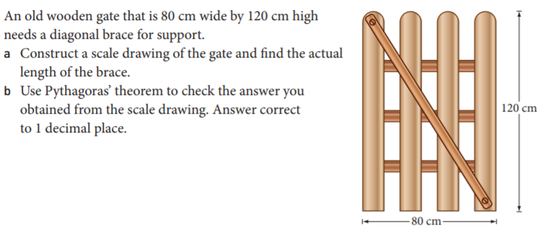
24
7
30
Scale Drawings
Date
EQ: How to produce scale drawings to use to build and decorate?
Try these:
Notes:
b) 144.2cm

Slide 5
24
7
30
Scale Drawings
Date
EQ: How to produce scale drawings to use to build and decorate?
Mathematical thinking task for Week 7
Please remember that this is preparation for your next Investigation that you will complete in Week 9 (after the EST)
Notes:
b) 144.2cm

